Slide 1
Tasks and Back Stack
A task is a collection of activities that users interact with when performing a certain job.
Activities are arranged with the order in which each activity is opened. This maintained stack called Back Stack

Slide 2
Example
For example, an email app might have one activity to show a list of new messages.
When the user selects a message, a new activity opens to view that message.
This new activity is added to the back stack.
If the user presses the Back button, that new activity is finished and popped off the stack.

Slide 3
Tasks and Back Stack
The device Home screen is the starting place for most tasks.
When the user touches an icon in the app launcher (or a shortcut on the Home screen), that app's task comes to the foreground.
If no task exists for the app (the app has not been used recently), then a new task is created and the "main" activity for that app opens as the root activity in the stack.

Slide 4
Tasks and Back Stack
When the current activity starts another, the new activity is pushed on the top of the stack and takes focus.
The previous activity remains in the stack, but is not in resumed state.
When an activity stops, the system retains the current state of its user interface.
When the user presses the Back button, the current activity is popped from the top of the stack (the activity is destroyed) and the previous activity resumes (the previous state of its UI is restored).

Slide 5
Tasks and Back Stack
Activities in the stack are never rearranged, only pushed and popped from the stack
Pushed onto the stack when started by the current activity
Popped off when the user leaves it using the Back button or by calling finish() .
As such, the back stack operates as a "last in, first out" object structure

Slide 6
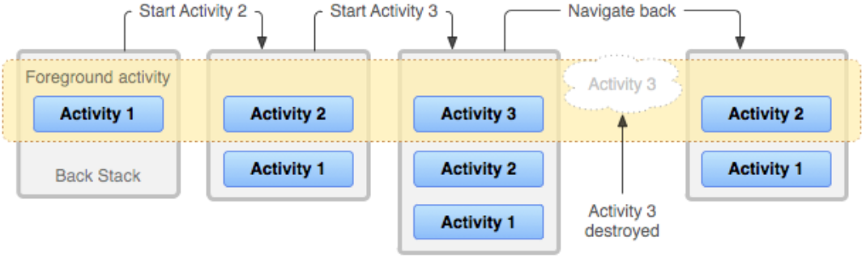
Tasks and Back Stack
Figure: A representation of how each new activity in a task adds an item to the back stack. When the user presses the Back button, the current activity is destroyed and the previous activity resumes.

Slide 7
Tasks and Back Stack
If the user continues to press Back, then each activity in the stack is popped off to reveal the previous one, until the user returns to the Home screen (or to whichever activity was running when the task began).
When all activities are removed from the stack, the task no longer exists.

Slide 8
Tasks and Back Stack
A task is a cohesive unit that can move to the "background" when users begin a new task or go to the Home screen, via the Home button.
While in the background, all the activities in the task are stopped, but the back stack for the task remains intact.
The task has simply lost focus while another task takes place.

Slide 9
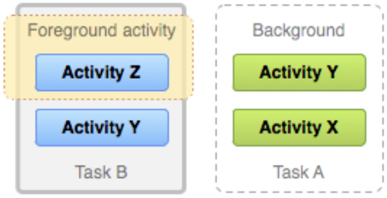
Tasks and Back Stack
Figure: Two tasks: Task B receives user interaction in the foreground, while Task A is in the background, waiting to be resumed

Slide 10
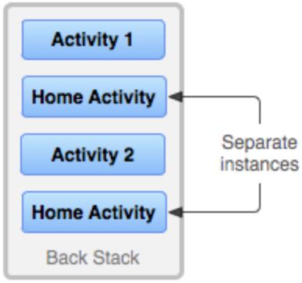
Tasks and Back Stack
Because the activities in the back stack are never rearranged, if your app allows users to start a particular activity from more than one activity, a new instance of that activity is created and pushed onto the stack (rather than bringing any previous instance of the activity to the top).
Notes:
Possible Lab

Slide 11
SUMMARY
When Activity A starts Activity B, Activity A is stopped, but the system retains its state (such as scroll position and text entered into forms). If the user presses the Back button while in Activity B, Activity A resumes with its state restored.
When the user leaves a task by pressing the Home button, the current activity is stopped and its task goes into the background. The system retains the state of every activity in the task. If the user later resumes the task by selecting the launcher icon that began the task, the task comes to the foreground and resumes the activity at the top of the stack.

Slide 12
SUMMARY
If the user presses the Back button, the current activity is popped from the stack and destroyed. The previous activity in the stack is resumed. When an activity is destroyed, the system does not retain the activity's state.
Activities can be instantiated multiple times, even from other tasks.

Slide 13
Managing Tasks
You might decide that you want to interrupt the normal behavior of an activity in the task.
Perhaps you want an activity in your app to begin a new task when it is started (instead of being placed within the current task);
or, when you start an activity, you want to bring forward an existing instance of it (instead of creating a new instance on top of the back stack);
or, you want your back stack to be cleared of all activities except for the root activity when the user leaves the task.
Notes:
https://inthecheesefactory.com/blog/understand-android-activity-launchmode/en

Slide 14
Managing Tasks
You can do these things and more, with attributes in the <activity> manifest element and with flags in the intent that you pass to startActivity().
Notes:
https://developer.android.com/reference/android/content/Intent#FLAG_ACTIVITY_NEW_TASK

Slide 15
Managing Tasks
In this regard, the principal <activity> attributes you can use are:
launchMode
taskAffinity
allowTaskReparenting
clearTaskOnLaunch
alwaysRetainTaskState
finishOnTaskLaunch

Slide 16
Defining launch modes
"standard"
This is the default launch mode of an activity (If not specified).
The system creates a new instance of the activity in the task from which it was started and routes the intent to it.
In other words you can create the same activity multiple times in the same task as well as in different tasks.
We can go back to the previous activity by pressing Back button.

Slide 17
Defining launch modes
"standard" example:
Suppose you have A, B, C and D activities and your activity B has “launch mode = standard”. Now you again launching activity B –
State of Activity Stack before launch B
A → B → C → D
State of Activity Stack after launch B
A → B → C → D → B
State of Activity Stack after launch B
A → B → C → D → B→ B

Slide 18
Defining launch modes
"singleTop"
If an instance of the activity already exists at the top of the current task, the system routes the intent to that instance through a call to its onNewIntent() method.
If an instance is not present on top of task then new instance will be created.
Generally, The activity can be instantiated multiple times, each instance can belong to different tasks, and one task can have multiple instances (but only if the activity at the top of the back stack is not an existing instance of the activity).

Slide 19
Defining launch modes
"singleTop“ Examples:
Case 1:
Suppose you have A, B and C activities and your activity D has “launch mode = singleTop”. Now you launching activity D
State of Activity Stack before launch D
A → D → B → C
State of Activity Stack after launch D activity
A → D→ B → C → D (Here D launch as usual)

Slide 20
Defining launch modes
"singleTop“ Examples:
Case 2:
Suppose you have A, B, C and D activities and your activity D has “launch mode = singleTop”. Now you again launching activity D
State of Activity Stack before launch D
A → B → C → D
State of Activity Stack after launch D activity
A → B → C → D
(Here old instance gets called and intent data route through onNewIntent() callback)

Slide 21
Defining launch modes
"singleTask“
If the instance of activity already exists all of activities placed above that singleTask activity would be automatically destroyed to make that an activity we want to appear on top of stack.
Only single instance of the activity can exist in the system.
If back button is pressed, user has to travel through the Activities in the stack before going back to the caller Task.

Slide 22
Defining launch modes
"singleTask“ Examples
Case 1:
Suppose you have A, B and C activities and your activity D has “launch mode = singleTask”. Now you launching activity D
State of Activity Stack before launch D
A → B → C
State of Activity Stack after launch D activity
A → B → C → D (Here D launch as usual)

Slide 23
Defining launch modes
"singleTask“ Examples
Case 2:
Suppose you have A, B, C and D activities and your activity B has “launch mode = singleTask”. Now you again launching activity B-
State of Activity Stack before launch B
A → B → C → D
State of Activity Stack after launch B activity
A → B
(Here old instance gets called and intent data route through onNewIntent() callback)
Also notice that C and D activities get destroyed here.

Slide 24
Defining launch modes
"singleInstance"
Same as "singleTask", except that the system doesn't launch any other activities into the task holding the instance.
The activity is always the single and only member of its task; any activities started by this one open in a separate task.
Since this Task could has only one Activity, we couldn't switch back.

Slide 25
Defining launch modes
"singleInstance" Examples:
Case-1: Suppose you have A, B and C activities and your activity D has “launch mode = singleInstance”. Now you launching activity D.
State of Activity Stack before launch D
Task1: A → B → C
State of Activity Stack after launch D activity
Task1: A → B → C
Task2: D (here D will be in different task)
Now if you continue this and start E and D then Stack will look like as follows:
Task1: A → B → C → E
Task2: D

Slide 26
Defining launch modes
"singleInstance" Examples:
Case 2: Suppose you have A, B, C activities in one task and activity D is in another task with “launch mode = singleInstance”. Now you again launching activity D-
State of Activity Stack before launch D
Task1: A → B → C
Task2: D
State of Activity Stack after launch D activity
Task1: A → B → C
Task2: D
(Here old instance gets called and intent data route through onNewIntent() callback)

